Slide 1
Impact of Community Centers on Shooting Incidents in New York City
Notes:
Hi, I’m Cory and this is my presentation on the New York Shooting Incident data analysis

Slide 2
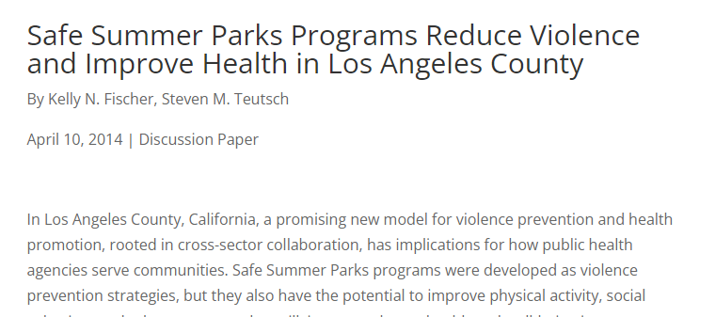
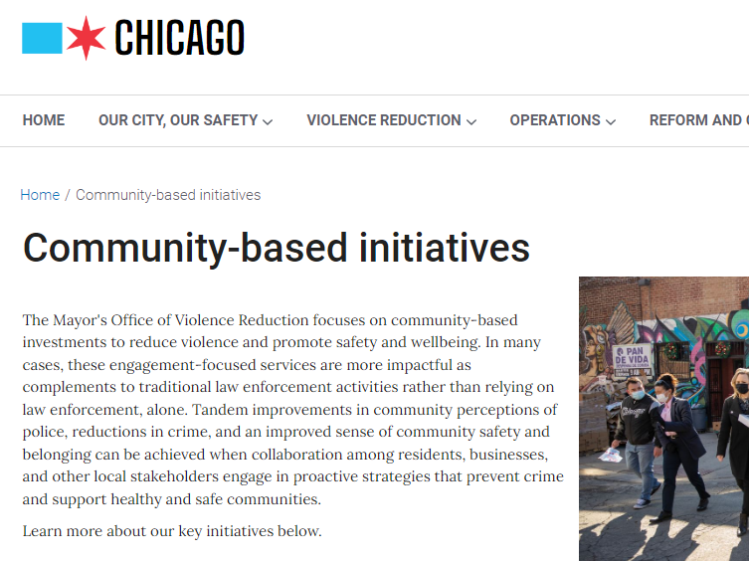
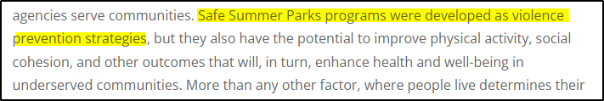

Notes:
It’s often reported that community centers have an active effect in reducing crime. I was interested in performing analysis to see if I could show that connection.

Slide 3
Data Sources
NYPD Shooting Incident Data https://catalog.data.gov/dataset/nypd-shooting-incident-data-historic
Facilities Database https://catalog.data.gov/dataset/facilities-database
Sharing NYC Police Precinct Data https://johnkeefe.net/nyc-police-precinct-and-census-data
Notes:
NYPD Shooting Incident Data, this is the data that was provided in class and contains every shooting incident that occured in New York City from 2006 through 2021.
Facilities Database: Locations and descriptions of public and private facilities in New York City. This data also includes the precinct each facility is in, which was convenient to join back to the original NYPD Shooting Incident data. I focused specifically on facilities from this database that enable community involvement, social engagement, and personal improvement.
A data set from this URL that provides 2020 Census population totals, broken down by precinct. This data was used to calculate both the shooting incidents and facilities available per thousand people in each precinct, so I could compare each precinct equally.

Slide 4
Method
Reviewed the number of community centers compared to the number of shooting incidents.
Selected a specific community center that opened in 2020 to see whether it’s opening had an impact on shooting incidents.
Notes:
Reviewed the number of community centers in each precinct compared to the number of shooting incidents that occured in the same precinct.
Selected a specific community center that opened in 2020 to see whether it’s opening had an impact on shooting incidents in the surrounding area.

Slide 5
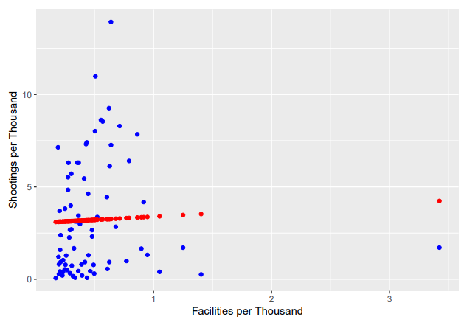
Community Center Impact on Shootings
Social and community-based facilities available to residents do not appear to have a direct impact on number of shooting incidents based on this data.
Fitting a linear model to this data also confirms that there does not appear to be a strong linear relationship between shooting incidents and facilities available.
Notes:
For each precinct, I plotted the number of facilities available per thousand residents versus the number of shootings that occurred in that same precinct. These are the blue points on this plot.
I also fit a linear model to this data to see if there was a clear linear relationship between the the number of shootings that occurred in a precinct and the number of facilities available. That linear model is the red plot.
I would have expected a negative slope linear relationship if the more facilities available in a precinct had an impact on the number of shootings in that same precinct. That’s not what we see here, however.

Slide 6
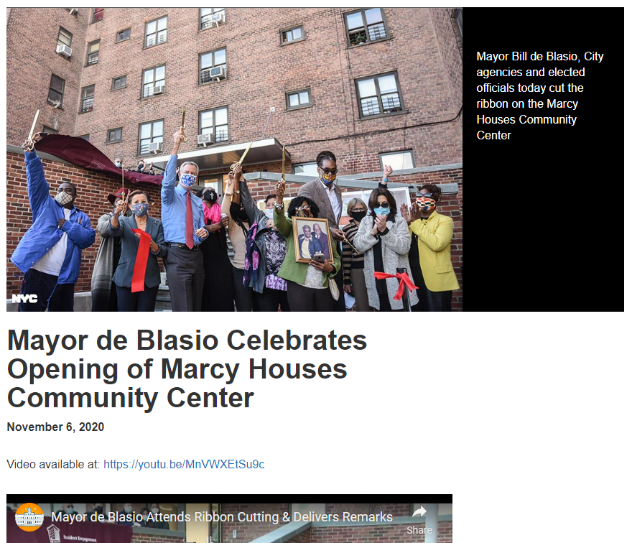
Notes:
I wanted to look closer at a specific community center that opened within the time period we have data for.
The Marcy Houses Community Center opened in November 2020, and I wanted to see if it’s opening had an effect on shootings in the surrounding area.

Slide 7
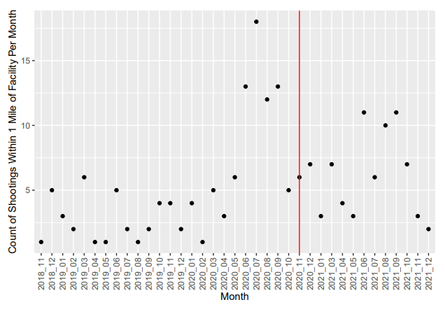
Marcy Houses Opening Case Study
While the number of shootings did decrease from the prior year, it isn’t obvious that the opening of the Marcy Houses Community Center had an effect on the number of shootings in the surrounding area.
Notes:
I isolated only the shooting incidents that occured within a mile of the Marcy Houses location and plotted the monthly incidents over time.
The vertical red line here is the opening of Marcy Houses. I looked specifically at the shooting incidents before and after Marcy Houses opened.
Especially on colder areas like New York, violence tends to occur more in the summer than the winter. So, looking at the summer months, as you can see, there is a sharp drop from the number of shooting incidents in summer of 2020, before Marcy Houses opened, and the summer of 2021, after it opened. But, the 2021 numbers are still high compared to 2018 and 2019.
So, I don’t think this data alone is sufficient to show that the opening of the Marcy Houses facility had an impact on shooting incidents in the area.

Slide 8
Biases and Further Study
My own strong feelings and assumptions about the subject
Potential biases in the data used and it’s collection
Potential increased violence due to societal events
Notes:
I personally come into this analysis with strong feelings about gun violence. I like the idea that fostering a sense of community in an area could promote empathy, provide opportunity, and reduce violence. I was disappointed when the data didn’t clearly show this relationship.
Further analysis should be done on how the shooting data was collected and if there was bias in the reported data. Has the data been reported accurately and completely by the police? Was the location data of the shooting incidents recorded accurately? In addition, the time period reviewed in this analysis does include the summer of 2020. This includes the civil unrest that followed the murder of George Floyde, which I suspect may account for some of the increased violence in the data. Additional analysis should be done, expanded to more cities, more community centers, and a broader time period, to achieve a more representative picture.
Gun violence is an incredibly complex and substantial subject. Much more in depth analysis will certainly be needed, both on how community centers impact gun violence, and on the many other factors that contribute to it

Slide 9
Thank you

